Slide 1
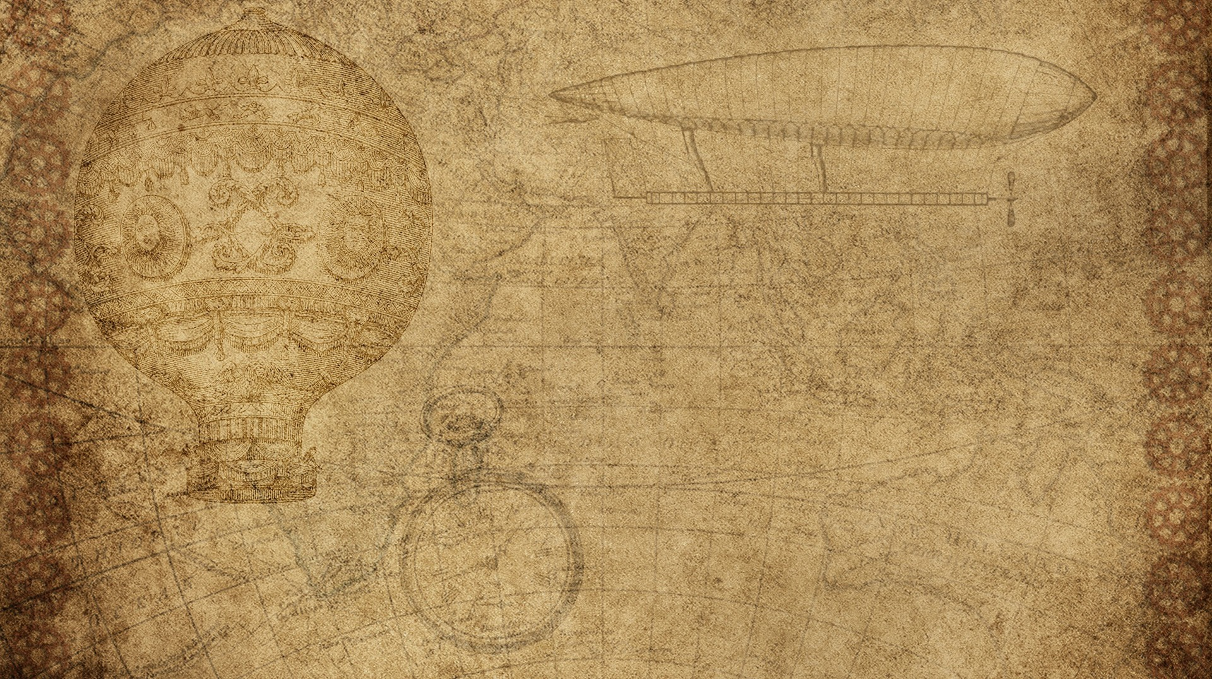
Program: ITAI 2372 – Artificial Intelligence
Portfolio
Name: Franck Kolontchang
About Me:
I am an AI student with strong hands-on experience in data analysis, machine learning models, Python programming, and visualization tools. My work this semester focused on building real projects using real datasets, exploring model performance, and developing AI solutions with practical applications.

Slide 2

Movie Rating & Performance Analysis
Skills Gained:
Installed/imported Python libraries (Pandas, NumPy, Matplotlib, Seaborn)
Conducted full EDA (handling missing values, correlations, distributions)
Created visualizations: heatmaps, bar charts, scatterplots
Built insights from features such as budget, revenue, popularity, and vote_average
What I Learned:
Understanding data quality, evaluating relationships between variables, using visualizations to interpret patterns, and producing insights for decision-making in film performance.

Slide 3

Projects Included in My Portfolio:
NewsBot Intelligence System (NLP):
Preprocessing, sentiment analysis, NER, and classification models.
Text Preprocessing Labs (SpaCy, NLTK):
Tokenization, lemmatization, stop-word removal, POS tagging.
Generative AI Startup Pitch:
Proposed “Paramount AI Studios” and designed a product powered by modern LLMs..
Tools Learned:
Python, Pandas, Matplotlib, Seaborn, SpaCy, NLTK, scikit-learn, Jupyter Notebook. Regression/Classification method.

Slide 4

Real-World Applications
I can apply my AI skills to solve problems in:
1-Retail & E-commerce
Pricing prediction / Inventory optimization
2- Healthcare
Prescription verification using ML / NLP models for medical text and Image interpretations
3- Agriculture (My real business background)
Yield predictions / Market-price forecasting
4- Media & Entertainment
Predicting movie success / Audience sentiment analysis

Slide 5

How People React to the Movie Agent Project
The Movie Performance Agent project received strong positive reactions because it solves a real problem: understanding which movies succeed and why. People appreciated that the project uses data, not opinion, to explain movie success.
Students, classmates, and professionals found the visualizations (scatter plots, heat maps, correlations) easy to understand and insightful. They often commented that this type of analysis feels similar to what real movie studios, streaming platforms (such as Netflix, Amazon, and Paramount), and advertisers use when making decisions.
Overall, the project was seen as practical, impressive, and directly applicable to real-world entertainment analytics.
<Insert pictures or drawings of your invention design/building process>
*you can insert a new slide for these pictures/drawings if you need to!

Slide 6

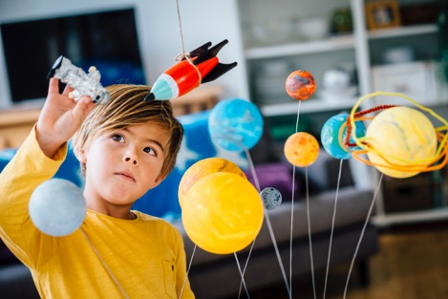
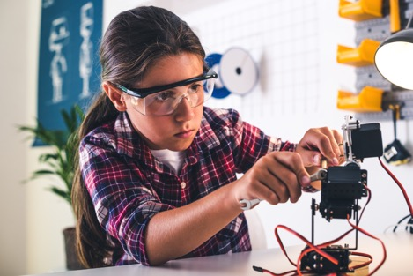
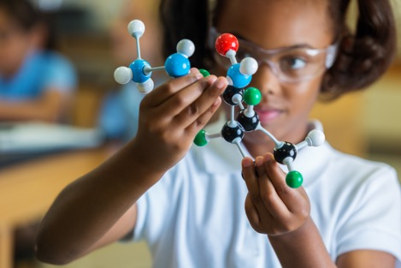
Who Are the Beneficiaries?
Movie Studios & Producers
2. Streaming Platforms (Netflix, Disney+, Amazon Prime)
3. Marketing Teams/ Investors & Analysts
4. Students & Beginners in Data Science
<Insert pictures or drawings of your invention being used, with a description entered here>
*you can insert a new slide for these pictures/drawings if you need to!
<Insert pictures or drawings of your invention being used, with a description entered here>
*you can insert a new slide for these pictures/drawings if you need to!
<Insert pictures or drawings of your invention being used, with a description entered here>
*you can insert a new slide for these pictures/drawings if you need to!

Slide 7
Wrap-Up & Contact
GitHub Repository:
https://github.com/Franckhcc/jupyter-exploration.git
Contact:
Email: kolontchangfranck@gmail.com
Phone: 832-305-0696
Additional Skills:
Machine Learning and Data Visualization
Python Programming
Presentation & communication skills

